Slide 1

Presentation On wallmart Data
By Akshit Maheshwari
Data Analyst Intern @ MENTORNESS
Batch - MIP-DA-13

Slide 2
What Is SQL ?
Structured Query Language is a domain-specific language used to manage data, especially in a relational database management system. It is particularly useful in handling structured data, i.e., data incorporating relations among entities and variables.
For many, SQL is the "meat and potatoes" of data analysis—it's used for accessing, cleaning, and analyzing data that are stored in databases. It's very easy to learn, yet it's employed by the world's largest companies to solve incredibly challenging problems

Slide 3
Analyzing Walmart Data
For a conglomerate as big as Walmart, it is necessary to organize and analyze the large volumes of data generated to make sense of existing performance and identify growth potential
Data analysis provides a deeper understanding of processes, behaviors, and trends. It allows organizations to gain insights into customer preferences, market dynamics, and operational efficiency

Slide 4

Problem Statement
Retrieve all columns for sales made in a specific branch (e.g., Branch 'A').
Find the total sales for each product line.
List all sales transactions where the payment method was 'Cash'.
Calculate the total gross income generated in each city.
Find the average rating given by customers in each branch.
Determine the total quantity of each product line sold.
List the top 5 products by unit price.
Find sales transactions with a gross income greater than 30.
Retrieve sales transactions that occurred on weekends.
Calculate the total sales and gross income for each month.
Find the number of sales transactions that occurred after 6 PM.
List the sales transactions that have a higher total than the average total of all transactions.
Calculate the cumulative gross income for each branch by date. 15. Find the total cogs for each customer type in each city.

Slide 5
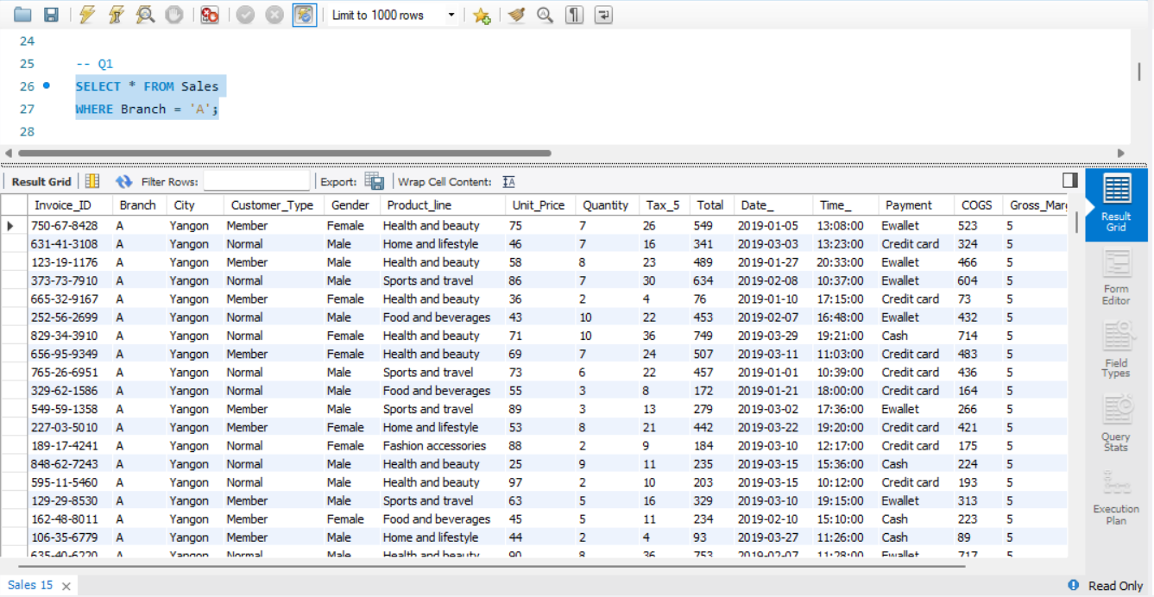
Retrieve all columns for sales made in a specific branch (e.g., Branch 'A')

Slide 6
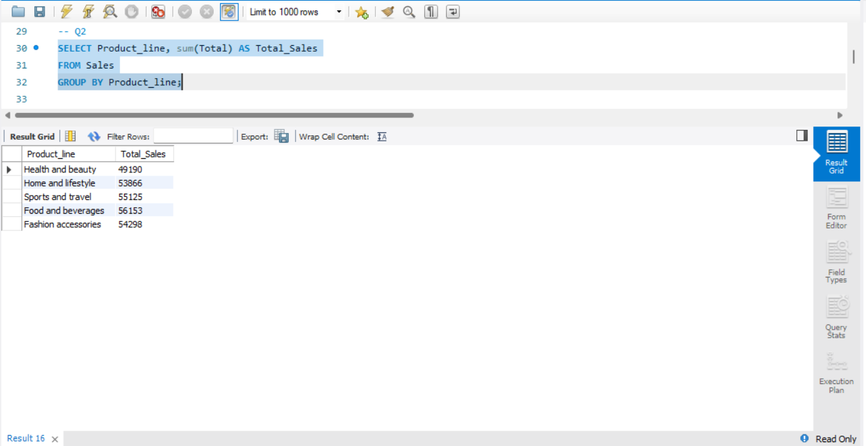
Find the total sales for each product line

Slide 7
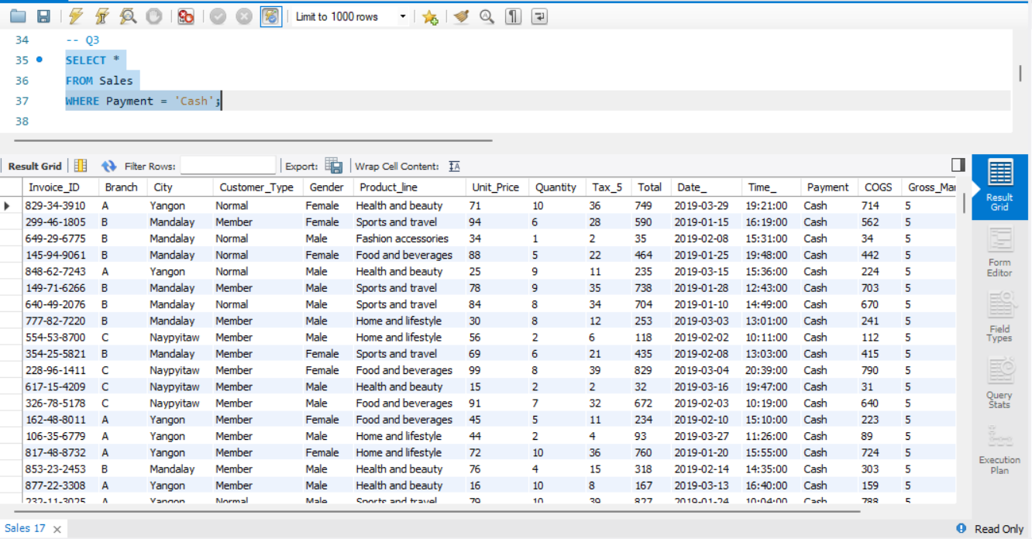
List all sales transactions where the payment method was 'Cash'

Slide 8
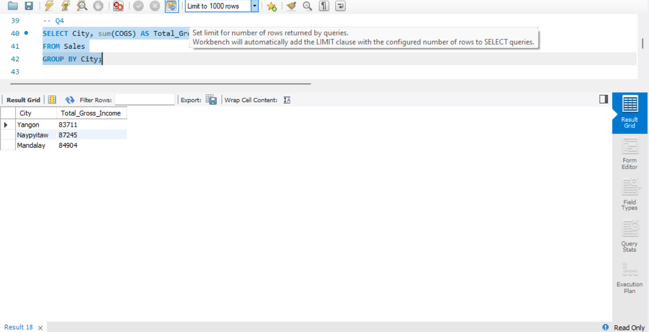
Calculate the total gross income generated in each city

Slide 9
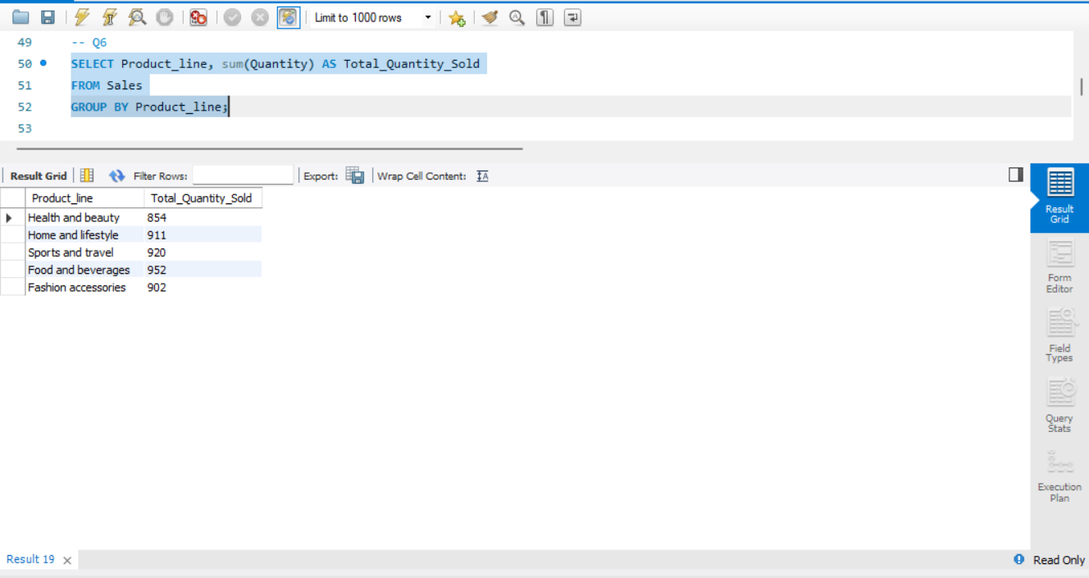
Determine the total quantity of each product line sold

Slide 10
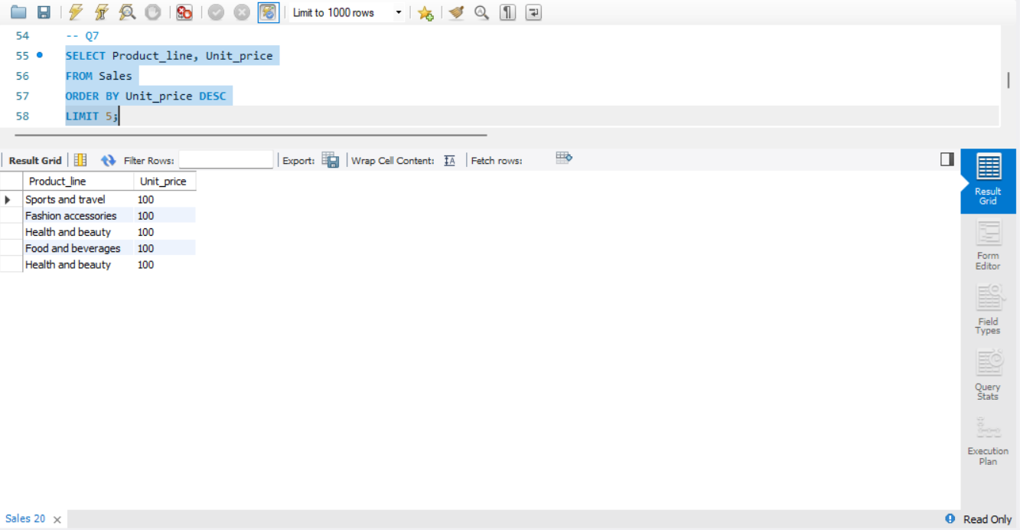
List the top 5 products by unit price

Slide 11
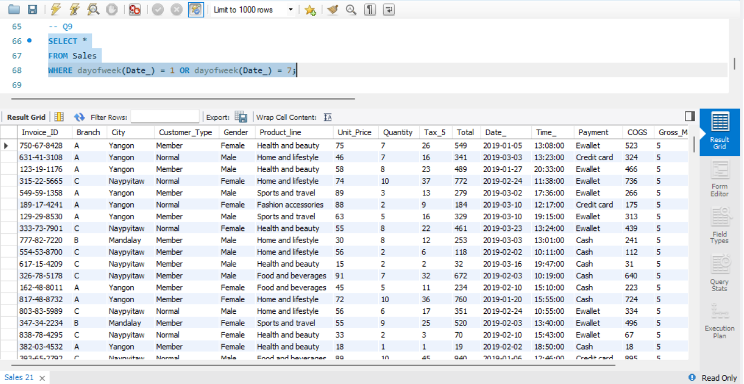
Retrieve sales transactions that occurred on weekends

Slide 12
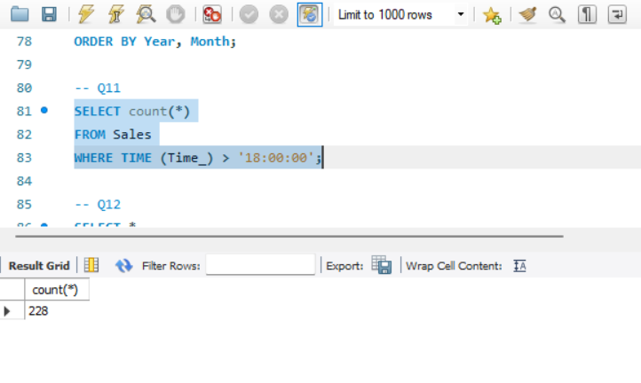
Find the number of sales transactions that occurred after 6 PM

Slide 13
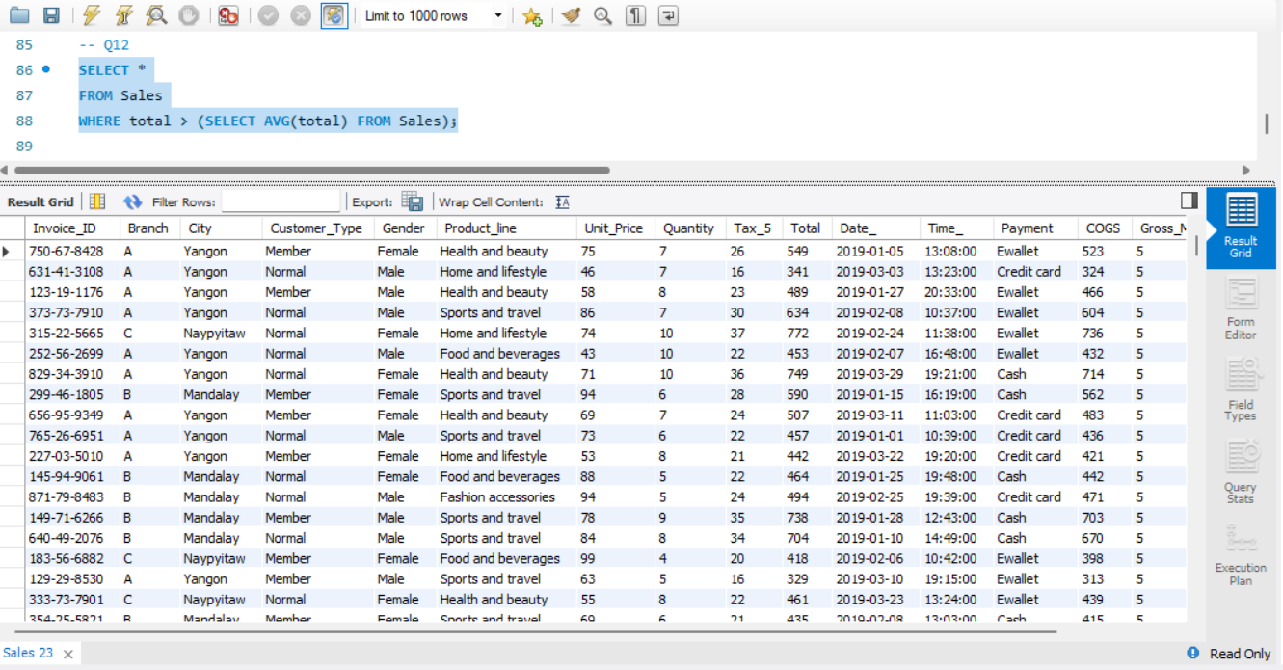
List the sales transactions that have a higher total than the average total of all transactions.

Slide 14


